Slide 1


AtilQ’s Hardware Sales Insights

Slide 2
📂 PRoject Overview
AtliQ Hardwares, a leading computer hardware manufacturer in India, sought to enhance its decision-making capabilities by leveraging data insights. Tony Sharma, the company’s Director of Data Analytics, initiated an SQL challenge for potential hires, aiming to find candidates proficient in both technical and soft skills. This project represents my completion of that challenge, demonstrating skills in SQL querying, data interpretation, and presentation design.

Slide 3
Top Products per Division
🎯 Project Objectives
APAC markets
Top Channel by Sales
Unique Product Increase
10
1
Ad-Hoc Request Analysis: Review and respond to 10 ad-hoc business requests from top-management to provide key insights
SQL Query Execution: Develop SQL queries to extract insights, answering each business question with precision
9
2
Max Quantity Quarter
8
3
Segment Product Counts
7
4
Monthly Gross Sales
6
5
Segment Product Growth
Top 5 Customers by Discount
Highest
& Lowest Cost Products

Slide 4
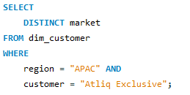
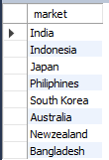
1. Provide the list of markets in which customer "Atliq Exclusive" operates its business in the APAC region.
Top Products per Division
APAC markets
Max Quantity Quarter
Top Channel by Sales
Query:
Output:
Top Channel by Sales
Unique Product Increase
7
8
Monthly Gross Sales
Top Products per Division
10
1
9
9
2
6
Top 5 Customers by Discount
10
Max Quantity Quarter
8
3
Segment Product Counts
APAC markets
5
7
4
Highest
& Lowest Cost Products
1
Monthly Gross Sales
6
5
Segment Product Growth
4
Unique Product Increase
Segment Product Growth
Segment Product Counts
3
2
Top 5 Customers by Discount
Highest
& Lowest Cost Products

Slide 5
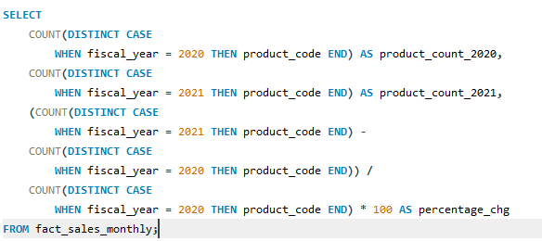

2. What is the percentage of unique product increase in 2021 vs. 2020? The final output contains these fields: unique_products_2020, unique_products_2021, percentage_chg
Top Channel by Sales
Top Products per Division
Query:
Insights:
9
Significant Product Expansions: The unique product count grew from 245 in 2020 to 334 in 2021, marking a 36.33% increases. This notable growth likely indicates a strategic focus on expanding product variety to capture a wider market, meet new customer needs, or enhance competitiveness.
Demand-Driven Product Growth: The substantial percentage increase suggests rising demand or an evolving product portfolio to keep up with market trends and consumer preferences.
Max Quantity Quarter
8
10
APAC markets
7
Monthly Gross Sales
1
Unique Product Increase
6
Top 5 Customers by Discount
2
3
Segment Product Counts
5
4
Highest
& Lowest Cost Products
Segment Product Growth
Output:

Slide 6
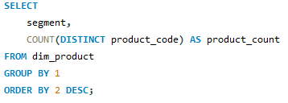
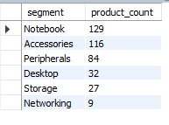
3. Provide a report with all the unique product counts for each segment and sort them in descending order of product counts. The final output contains 2 fields: segment, product_count
Top Products per Division
APAC markets
Query:
Insights:
Top Channel by Sales
Varieties of Products: With a product count of 129, the “Notebook” segment leads in variety, indicating a focus on offering a broad selection to meet diverse customer needs or preferences.
Strong Offerings: “Accessories”(116) and “Peripherals”(84) also have high product counts, reflecting a wide range of related product.
Smaller Focus: The “Networking” segment has the fewest products (9), with “Storage”(27) and “Desktop”(32) having moderate counts, indicating lower customer demands.
Unique Product Increase
10
1
9
2
Max Quantity Quarter
8
3
Segment Product Counts
7
4
Monthly Gross Sales
6
5
Segment Product Growth
Top 5 Customers by Discount
Highest
& Lowest Cost Products
Output:

Slide 7
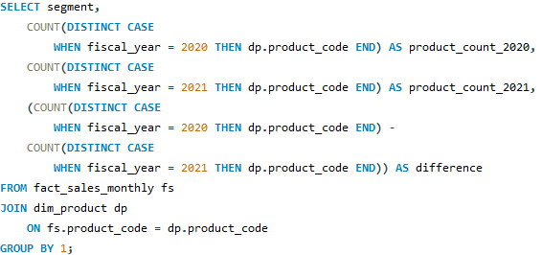
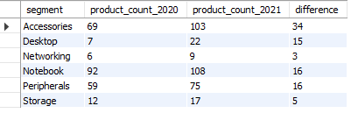
4. Follow-up: Which segment had the most increase in unique products in2021 vs 2020? The final output contains these fields: segment, product_count_2020, product_count_2021, difference
APAC markets
Unique Product Increase
Query:
Insights:
2
Highest Growth: The “Accessories” segment shows the most significant increases in unique products, growing from 69 in 2020 to 103 in 2021 with a difference of 34 products. This indicates a strategic expansion or high demand in the accessories category.
Consistent Growth: All segments show positive growth in product counts, with “Notebook” and “Peripherals” each increasingly by 16 products. This steady expansion suggests a broad product diversification strategy.
Top Products per Division
Segment Product Counts
1
3
4
10
Segment Product Growth
Top Channel by Sales
5
9
Highest
& Lowest Cost Products
Max Quantity Quarter
8
6
7
Monthly Gross Sales
Top 5 Customers by Discount
Output:

Slide 8
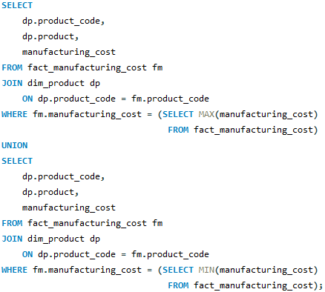

5. Get the products that have the highest and lowest manufacturing costs. The final output should contain these fields: product_code, product, manufacturing_cost
Unique Product Increase
Segment Product Counts
Query:
Insights:
3
4
APAC markets
Segment Product Growth
Cost-Efficient Product: “AQ Master wired x1 Ms” has the lowest manufacturing cost, suggesting it might be a simple or highly optimized product in terms of production. Its low cost could make it an attractive product for bulk sales with higher profit margins.
Premium Products: The high manufacturing cost of “AQ Home Allin 1 Gen 2” indicates it may be a premium product.
2
5
1
Highest
& Lowest Cost Products
Top Products per Division
6
10
Top 5 Customers by Discount
Top Channel by Sales
7
Max Quantity Quarter
Monthly Gross Sales
9
8
Output:

Slide 9
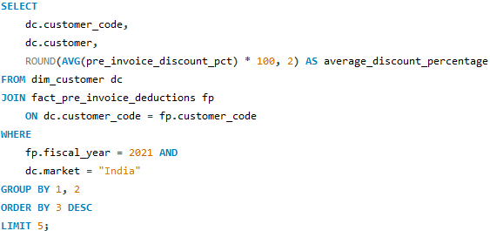
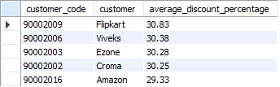
6. Generate a report which contains the top 5 customers who received anaverage high pre_invoice_discount_pct for the fiscal year 2021 and in the “Indian” market. The final output contains these fields: customer_code, customer, average_discount_percentage
4
Segment Product Growth
5
3
Segment Product Counts
Query:
Insights:
Highest
& Lowest Cost Products
High discounts for E-commerce: Flipkart and Amazon, leading e-commerce platforms, are in the top five customers receiving the highest average discounts, with Flipkart receiving the highest at 30.83%.
Consistent discount range: The top five customers receive close discount percentages, all around 29-31%. This indicates a pricing strategy aimed at maintaining competitive relationships with major retailers across both e-commerce and physical outlets.
Unique Product Increase
2
6
APAC markets
Top 5 Customers by Discount
7
1
Monthly Gross Sales
Top Products per Division
Max Quantity Quarter
8
Top Channel by Sales
10
Output:
9

Slide 10
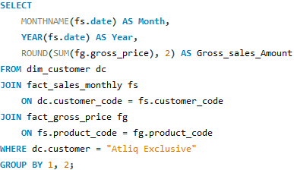
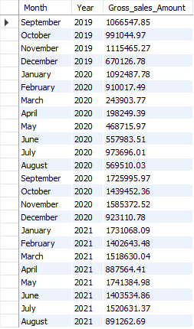
7. Get the complete report of the Gross sales amount for the customer “Atliq Exclusive” for each month. This analysis helps to get an idea of low and high-performing months and take strategic decisions. The final report contains these columns: month, year, gross sales amount
4
5
Segment Product Growth
Highest
& Lowest Cost Products
6
Query:
Output:
Segment Product Counts
Top 5 Customers by Discount
3
7
Monthly Gross Sales
Unique Product Increase
2
APAC markets
Max Quantity Quarter
8
1
Top Products per Division
Top Channel by Sales
Insights:
10
9
Peak sales Months : The month November have significantly higher sales compared to others month due to year-end sales and holiday.

Slide 11
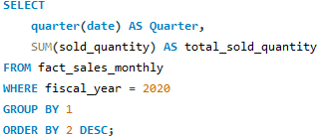

8. In which quarter of 2020, got the maximum total_sold_quantity? The finaloutput contains these fields sorted by the total_sold_quantity: quarter total_sold_quantity
5
6
4
Highest
& Lowest Cost Products
Top 5 Customers by Discount
7
Segment Product Growth
Query:
Insights:
Monthly Gross Sales
Peak Sales in Q4: The fourth quarter has the highest total sold quantity by a large margin, with 84,25,822 units sold. This spike could indicate seasonal demand, possibly due to holiday or year-end series.
Sales in Q3: The third quarter has significant total sold quantity of 52,46,770 units. In the second half of the year the units sold is getting increased.
Sales in Q1 and Q2: Q1 and Q2 have significantly lower sales compared to Q3 and Q4, suggesting an opportunity to boost sales during the first half of the year, potentially through targeted promotions or product availability improvements.
3
Segment Product Counts
Max Quantity Quarter
8
Unique Product Increase
Top Channel by Sales
APAC markets
Top Products per Division
2
9
Output:
1
10

Slide 12
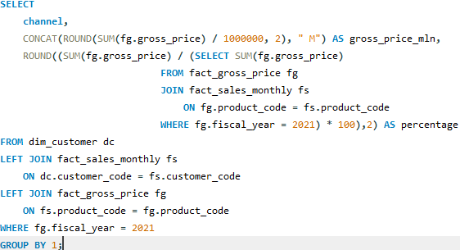

9. Which channel helped to bring more gross sales in the fiscal year 2021and the percentage of contribution? The final output contains these fields: channel, gross_sales_mln, percentage
6
7
Top 5 Customers by Discount
Monthly Gross Sales
5
Query:
Insights:
Retailer Channel: The “Retailer” channel contributes significantly to gross sales, accounting for 77.47% of the total revenue with $133.77 million. This suggests that retailers are the primary drivers of sales, highlighting their importance in the sales strategy.
Direct Channel: The “Direct” channel generates $33.73 million, representing 19.53% of total_sales. While lower than retail, this direct channel might offer growth opportunities for increasing profitability through direct consumer engagement.
Distributor Channel: The “Distributor” channel contributes the least, with only $5.19 million, representing 3.00%. If expanding distributor reach aligns with business goals, it may indicate room for channel improvement.
Highest
& Lowest Cost Products
Max Quantity Quarter
8
4
Segment Product Growth
Top Channel by Sales
Top Products per Division
9
3
Segment Product Counts
APAC markets
10
Unique Product Increase
Output:
2
1

Slide 13
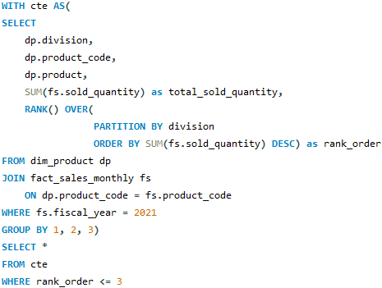
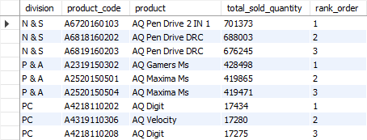
10. Get the Top 3 products in each division that have a high total_sold_quantity in the fiscal_year 2021? The final output contains these fields: division, product_code, product, total_sold_quantity, rank_order
7
Monthly Gross Sales
6
Max Quantity Quarter
8
Query:
Insights:
Top 5 Customers by Discount
Top-Selling Division: The “N&S” division leads in terms of total sales, with the top three products all reaching sales over 670,000 units, showing strong demand for the “AQ Pen Drive” series.
Popular Product Segments: In both “N&S” and “P&A” divisions, storage devices like “AQ Pen Drives” and peripherals like “AQ Gamers Ms” and “AQ Maxima Ms” dominate the top ranks, indicating a high demand for these categories within their respective divisions.
Lower-Selling Division: The “PC” division has significantly lower total sold quantities for its top products, with “AQ Digit” and “AQ Velocity” reaching around 17,000 units. This suggests either a smaller market reach or lower demand for “PC” division products compared to the “N&S” and “P&A” divisions.
Top Channel by Sales
5
Top Products per Division
9
Highest
& Lowest Cost Products
4
10
Segment Product Growth
APAC markets
3
Segment Product Counts
Unique Product Increase
1
Output:
2

Slide 14
🚀 Project Highlights
💼 Key Skills Demonstrated
SQL Proficiency: Demonstrated strong SQL skills, including data retrieval, aggregation, and analysis.
Business Insight Generation: Translated raw data into actionable insights that support data-driven decisions.
Visual Story Telling: Designed a presentation that meets executive standards, emphasizing clarity and business relevance.
SQL for Data Analysis: Complex queries to address business-specific requests.
Analytical Thinking: Addressing ad-hoc questions with a problem-solving approach
Insight Communications: Effective storytelling in both static and narrated formats.
🏁 Conclusion
Through this project, I gained practical experience in SQL querying, data interpretation, and executive-level presentation skills. This challenge provided an excellent opportunity to showcase my ability to derive insights from data and communicate findings in a way that supports high-level business decisions.

